Slide 1
MOBILE PRICE PREDICTION USING MACHINE LEARNING

Slide 2
TABLE OF CONTENTS
Agenda
Understanding the features
Process followed in the project
Deductions from EDA process
Illustration of some plots
Procedure followed for data cleaning
Model 1 and Model 2 description and result

Slide 3
Agenda
The Motivation behind it to know about the various kinds of mobile prices based on the features.
Because now a days most of the E-Commerce website are focusing to sell the mobile to consumers.
So the peoples need to aware of the mobiles prices based on the features they want.

Slide 4
Understanding the variables
Battery Power
ROM
RAM
Primary camera
Selfie camera
Mobile size
Mobile Price
In this project Mobile price has been taken as the dependent variable other variables are independent variables.

Slide 5
PROCESS FOLLOWED IN THE PROJECT
Data Collections
Data Preprocessing
Exploratory Data Analysis
Feature Selection
Building a model using Decision Tree and Random Forest Algorithms

Slide 6
EDA process
Finding the correlation between each variables using heatmap
Finding the Null Values in Each of the Columns
Keywords have been plotted using the Countplot

Slide 7
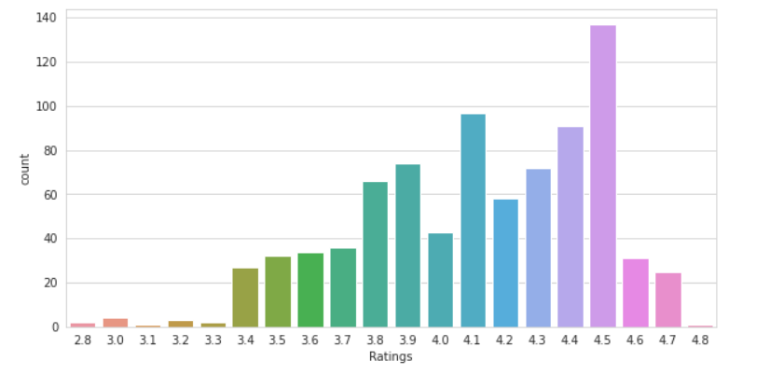
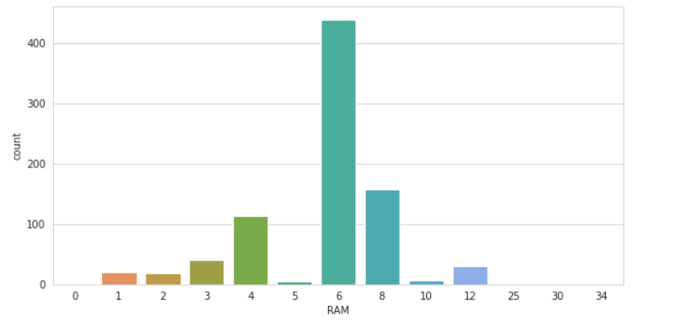
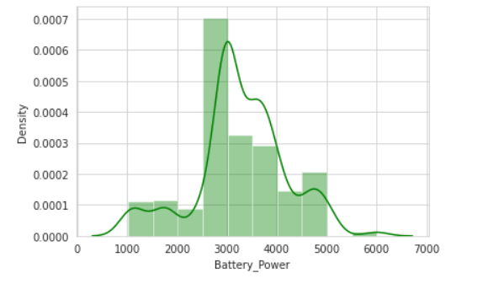
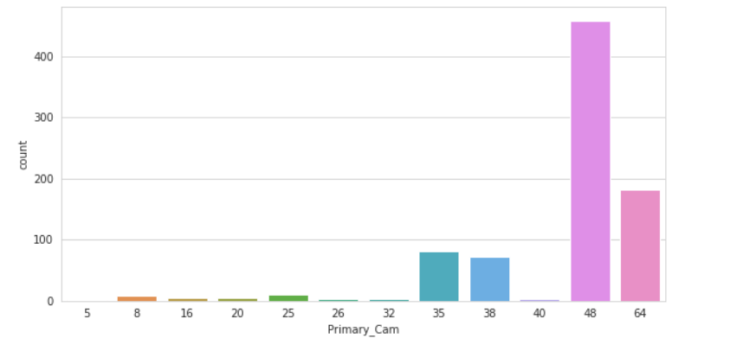
Illustration of some plots

Slide 8
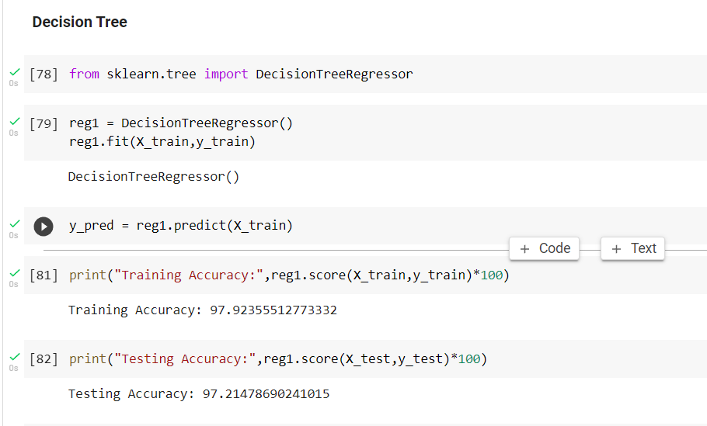
MODEL 1
Decision tree regressor is the first model used to build the mobile price predictor

Slide 9
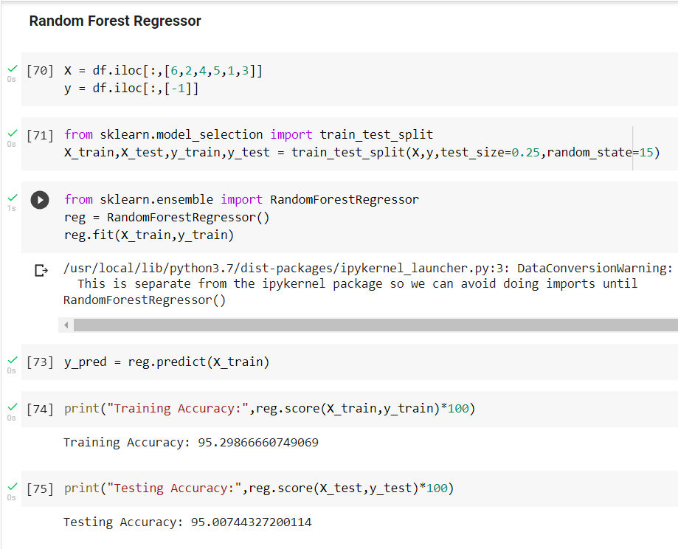
MODEL 2
Random Forest regressor is the first model used to build the mobile price predictor

Slide 10
RESULT
The Decision Tree Regressor give the accuracy of 97.21%
The random Forest Regressor give the accuracy of 95.29%
While comparing each model the Decision Tree Regressor give the more accuracy
So that the Decision Tree Regressor is taken for deployment of the model

Slide 11
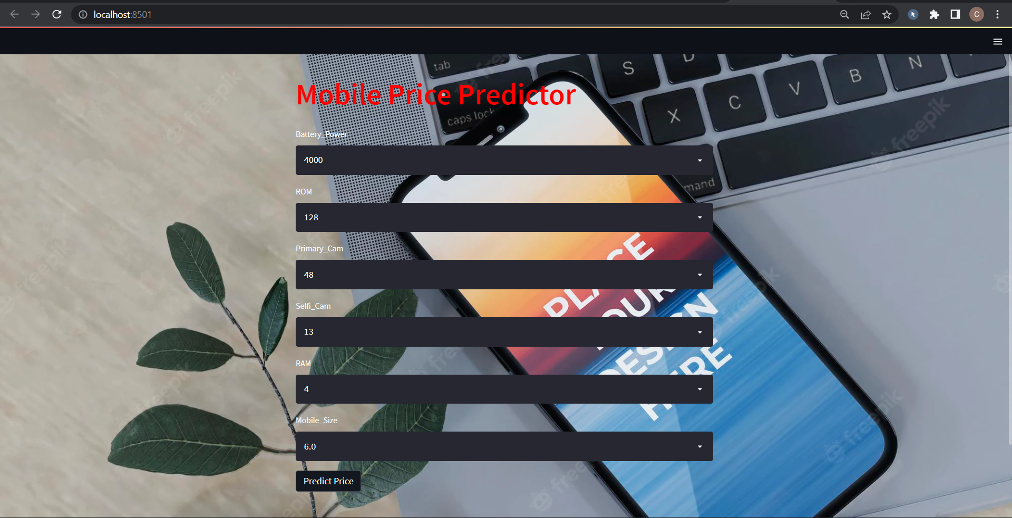
OUTPUT
Streamlit is used for creating the Web Application
Streamlit is an open source app framework in Python language.

